Slide 1
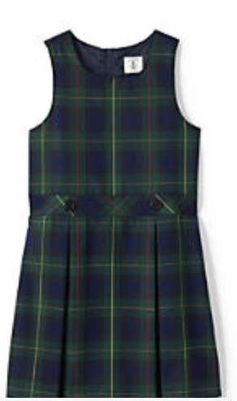
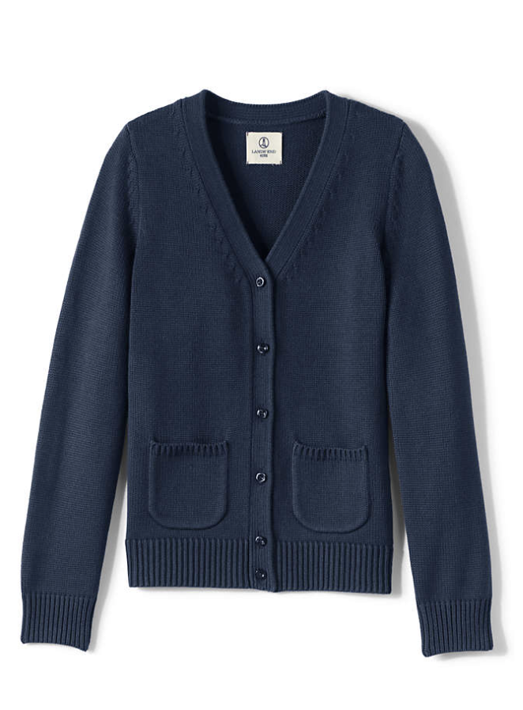
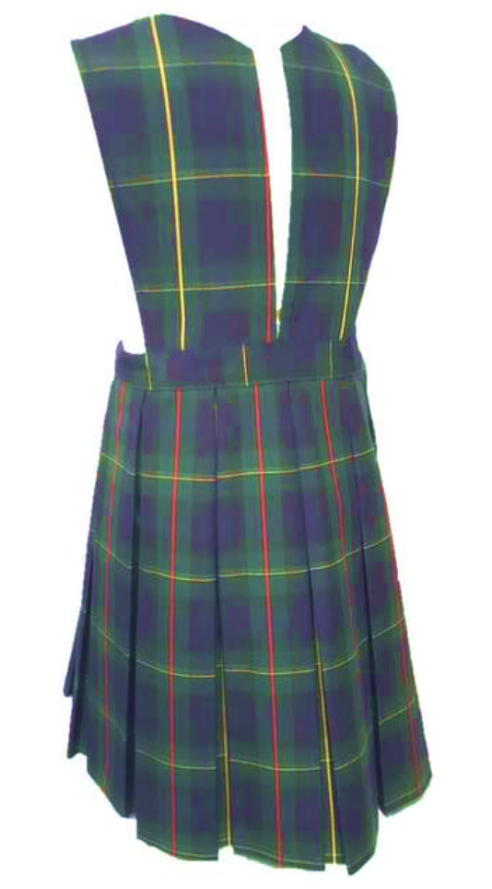
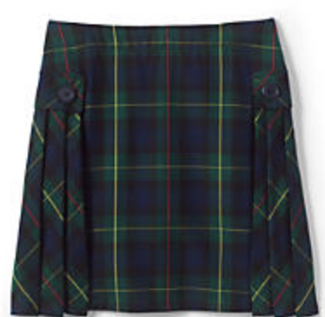
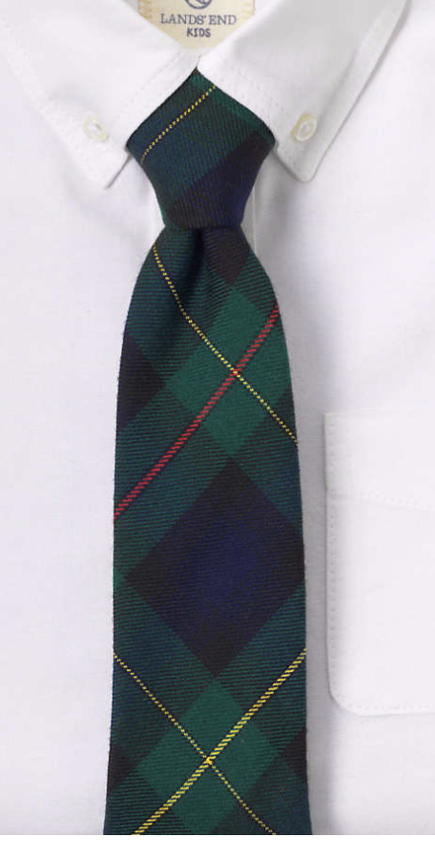
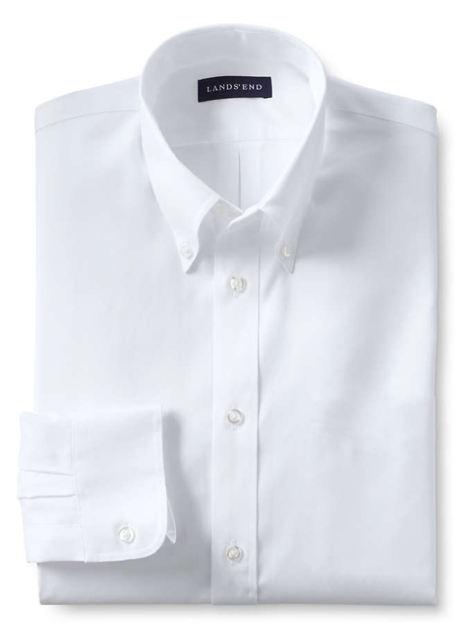
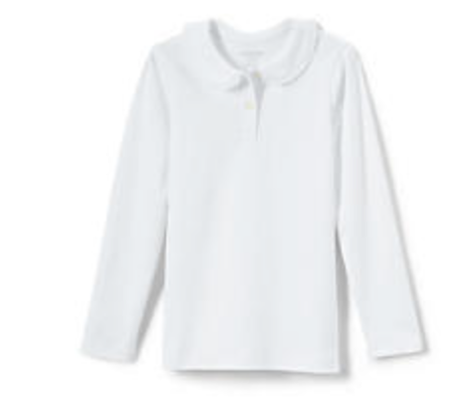
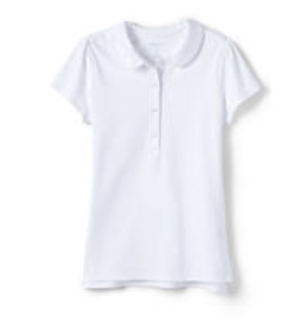
jfjf
SAINT PETER CATHOLIC SCHOOL - GIRLS MASS UNIFORM
TUESDAY ATTIRE
K-5 Uniform
Middle School Uniform
Sweater K-8
Logo Optional
on Sweater
Socks – Black or Navy. Must cover the ankles.
Girls tights (No legging) - Black, white, navy.
Shorts under jumper (Bicycle type)
White Shirt
Long or short Sleeve
(Girls can wear ¾ sleeve)
White Shirt
Long, short or 3/4 Sleeve

Slide 2
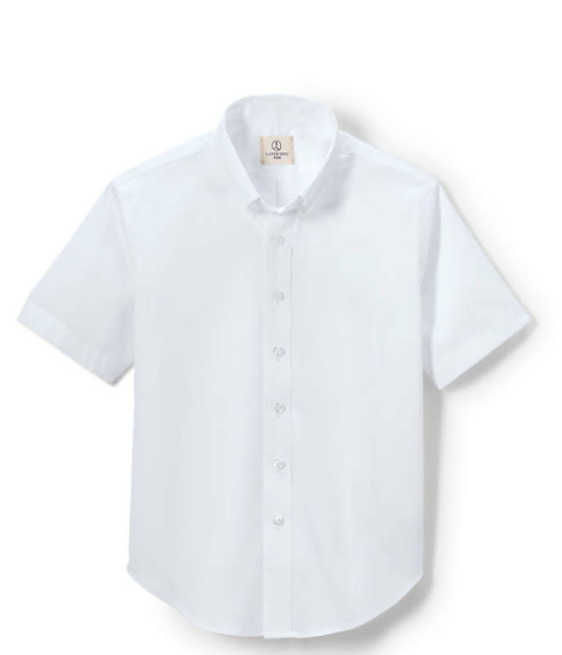
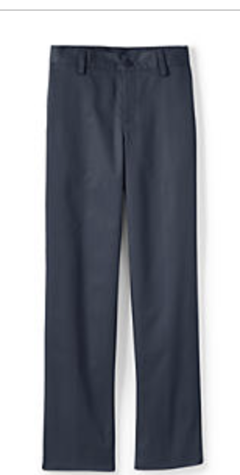
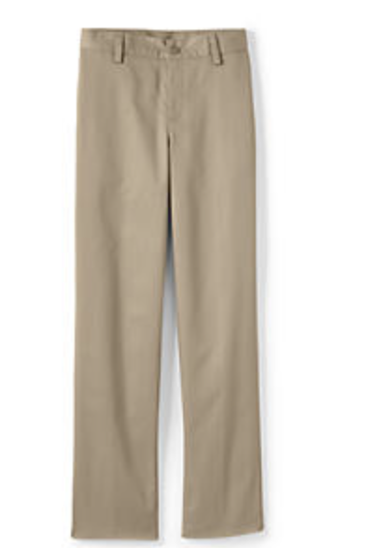
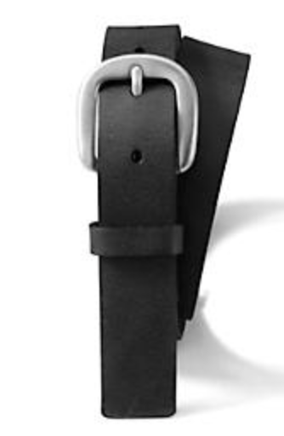
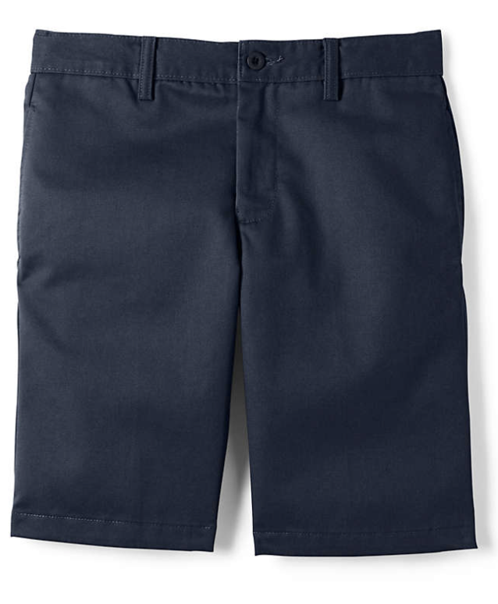
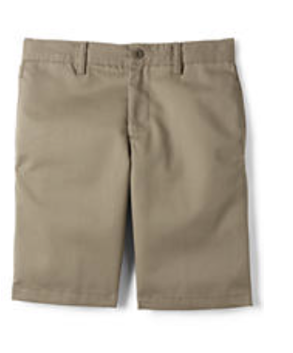
SAINT PETER CATHOLIC SCHOOL - BOYS MASS UNIFORM
TUESDAY ATTIRE
Middle School Uniform
Khaki – No pockets with rivets
BLACK OR BROWN BELT
Belts required grades 2-8
K-5 Uniform (Navy)
No pockets with rivets
Socks – Black or Navy.
Must cover the ankles.
Sweater K-8
Logo optional
on sweater

Slide 3
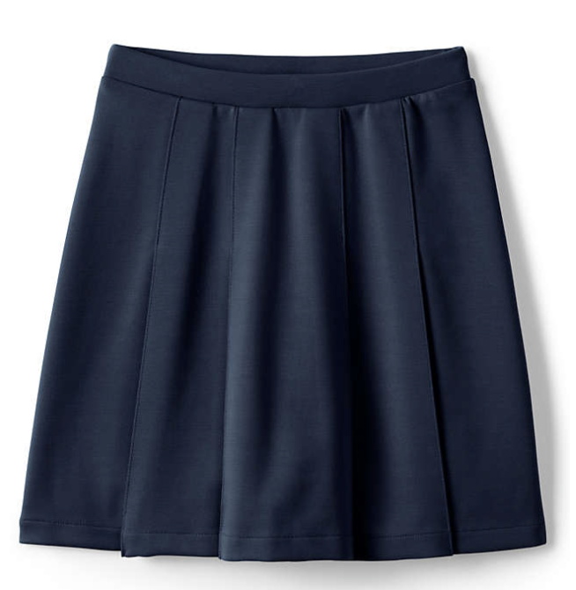
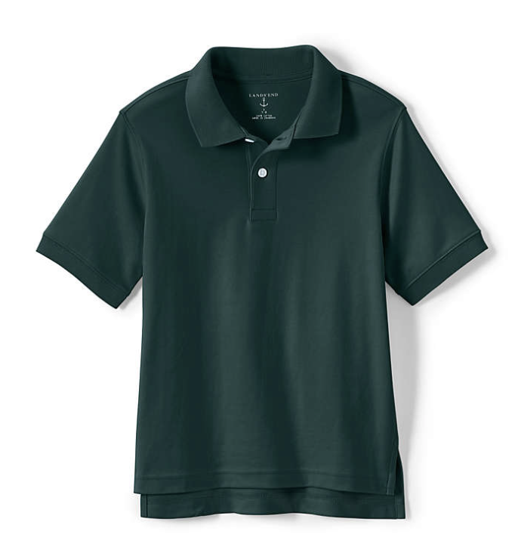
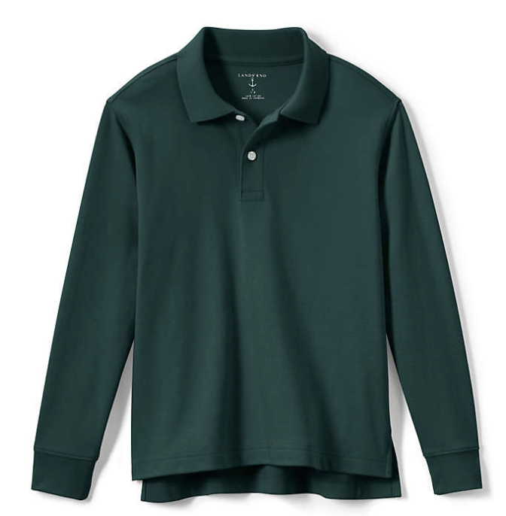
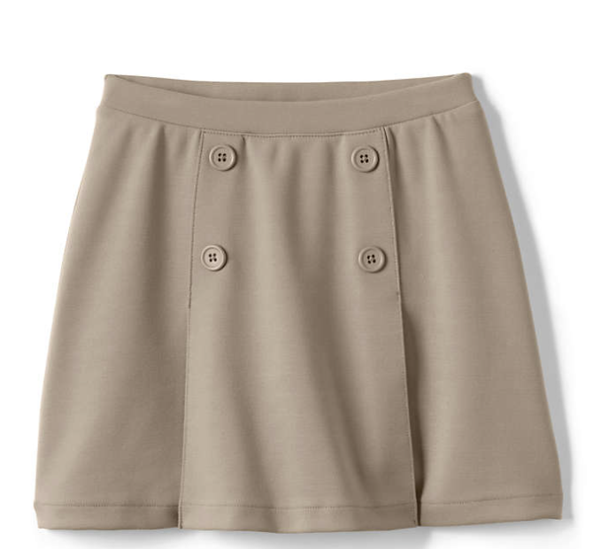
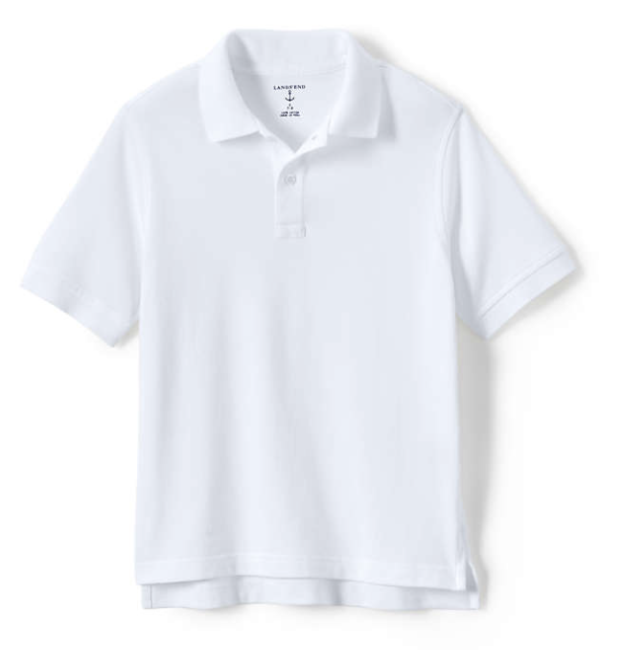
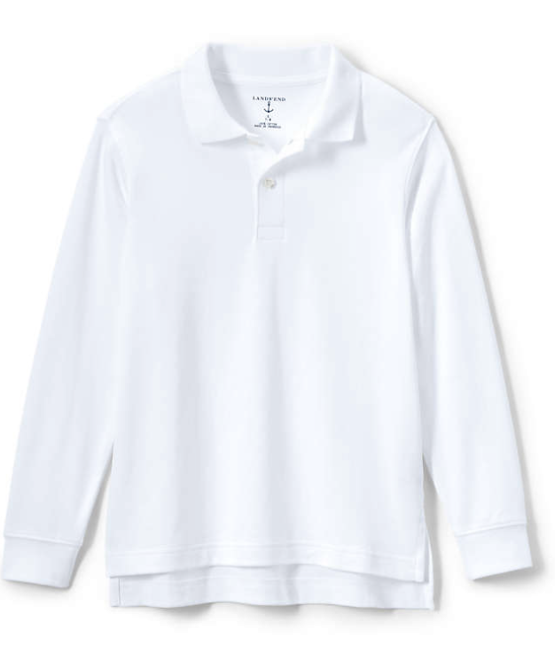
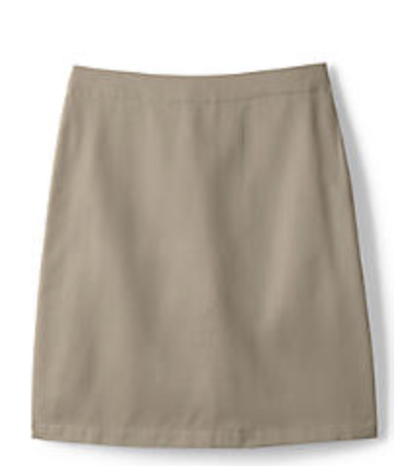
SAINT PETER CATHOLIC SCHOOL – DAILY ATTIRE (BOYS AND GIRLS)
THURSDAY AND FRIDAY
K-5 Uniform (Navy)
No pockets with rivets
K-8* Uniform
(Green)
Middle School Uniform - Khaki
No pockets with rivets
Logo Required on Polo Shirts
BLACK OR BROWN BELT
Belts required grades 2-8
Socks – Black, white, navy or green. Must cover the ankles.
Girls tights (No legging) - Black, white, navy.
Middle School Uniform 6th – 8th (White)
*Middle School students may wear the green polo

Slide 4
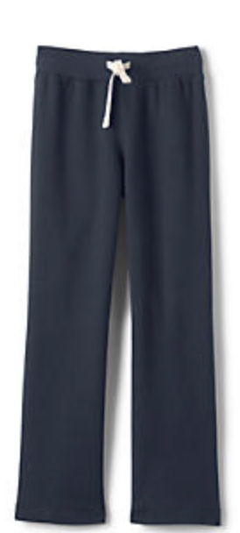
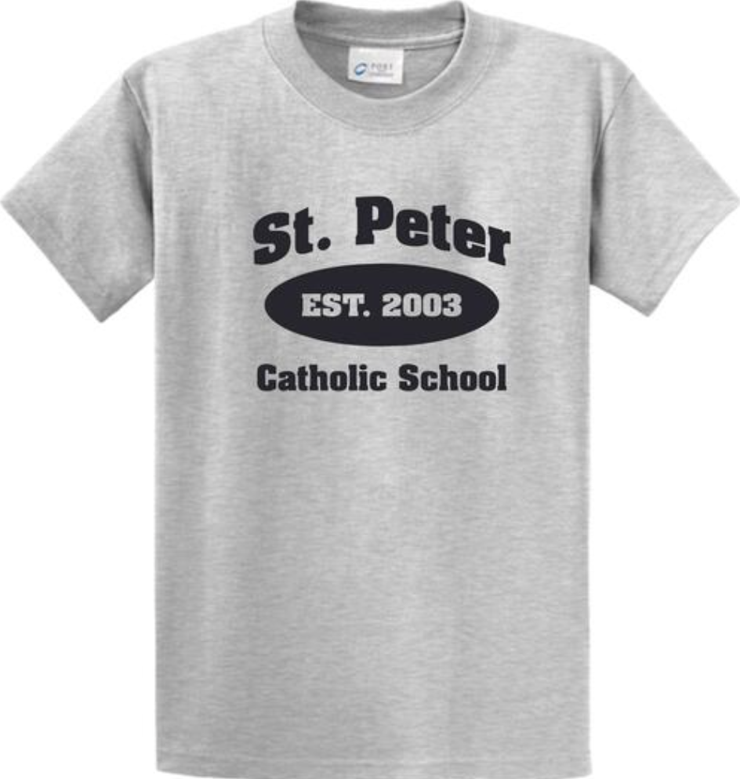
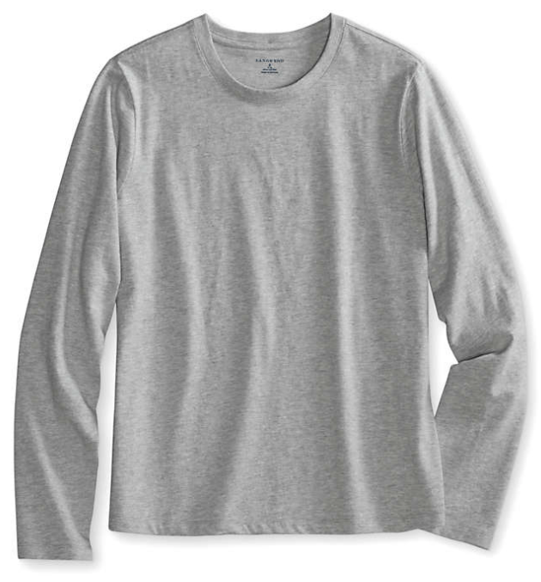
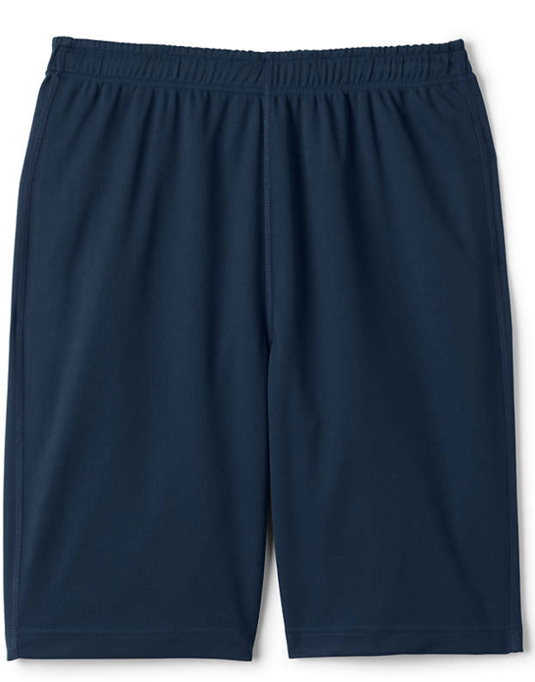
SAINT PETER CATHOLIC SCHOOL – PHYSICAL EDUCATION UNIFORM
MONDAY AND WEDNESDAY ATTIRE
Pants and shorts must be navy
fabric must be cotton or mesh
No logo
Logo required on shirts only
K-5 Socks – White, No Logo
6-8 Socks – White, May have a logo

Slide 5
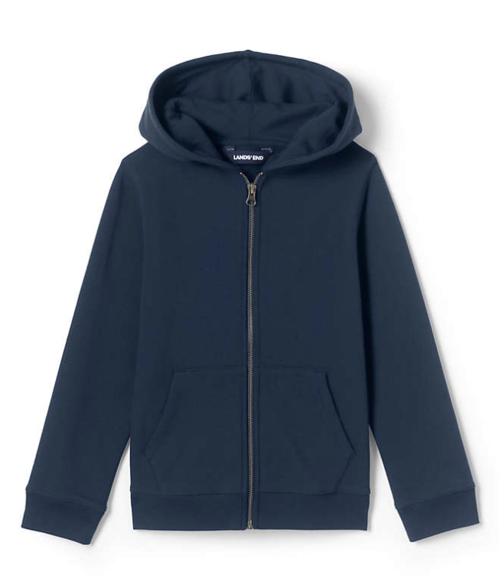
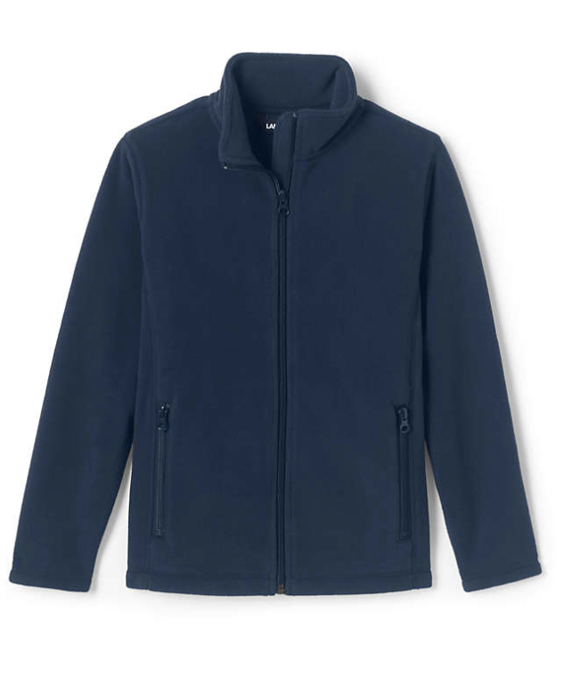
SAINT PETER CATHOLIC SCHOOL - OUTER WEAR
Fleece Jacket
Casual Cotton Hoodie
Logo required on jackets

Slide 6
SUPPLIERS
https://www.landsend.com
School Code: 900159377
https://Denver.educationaloutfitters.com
Address: 8170 S University Blvd Ste 250, Centennial, CO 80122
Phone: 720-200-6666
https://www.dennisuniform.com
School Code: CPT
Address: 8600 Park Meadows Dr Ste 700, Lone Tree, CO 80124
Phone: 303-738-2255
https://www.frenchtoast.com
St.-Peter-Catholic-School-QS5ZWNL

Slide 7
FOOTWEAR BY DAY
​Monday and Wednesday: PE days - Shoes must be white, black, navy blue or gray athletic shoes/sneakers with white or light colored bottoms.
Monday, Tuesday, and Wednesday: Shoes must be white, black, navy blue or gray. Shoes may be leather, mesh, or canvas. No open toe shoes or heels.

